Slide 1




Slide 2


Positional Encoding
Notes:
Hello and Welcome, in this video, we will discuss one of the most important components in the transformers' architecture. Positional Encoding.

Slide 3


Missing Positional Info Problem
Passing embeddings only to transformers
missing a big chunk of context information
Notes:
as we know from the last video, we pass the embeddings to the Transformer with no idea of a word's position in a sequence,. Which leads to missing a big chunk of context information.

Slide 4
Independent positional vectors Problems
high cost on the training speed of the Transformer.
make attention sub-layers very complex to work with.
Positional vectors
Positional vectors
Notes:
Also, we cannot create independent positional vectors, as it would have a high cost on the training speed of the Transformer. and make attention sub-layers very complex to work with.

Slide 5
Positional Encoding
The idea is to add a positional encoding value to the input embedding. instead of having additional vectors to describe the position of a token in a sequence.
…
Encoding stack
Token Embeddings
Notes:
The idea is to add a positional encoding value to the input embedding. instead of having additional vectors to describe the position of a token in a sequence. We also know that the Transformer expects a fixed size inputs .

Slide 6
Positional Encoding
The idea is to add a positional encoding value to the input embedding. instead of having additional vectors to describe the position of a token in a sequence.
…
1x512
Encoding stack
Token Embeddings
Notes:
let’s say 512 , for each vector of the output of the positional encoding function.

Slide 7
Positional Encoding Problem
brown
“ The black cat sat on the couch and the brown dog slept on the rug. “
The word black is in pos=2
The word brown is in pos=10
Our problem is to find a way to add a value to the word embedding of each word. so that it has information about its position. we need to add a value to the 512 dimensions For each word embedding vector
black
The
=>
black
cat
…
…
…
rug
1x512
1x512
Token Embeddings
Positional Encoding
Notes:
So we need to find a way to provide information to i in the range of 0 and 512 dimensions. of the word embedding vector of black and brown.

Slide 8
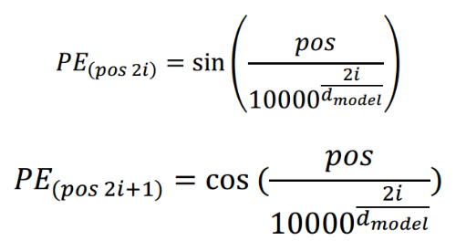
Positional Encoding Functions
use a unit sphere to represent positional encoding with sine and cosine values. that will thus remain small but very useful.
Notes:
There are many ways to achieve this goal. The transformer authors found a clever way to use a unit sphere to represent positional encoding with sine and cosine values. that will thus remain small but very useful.

Slide 9
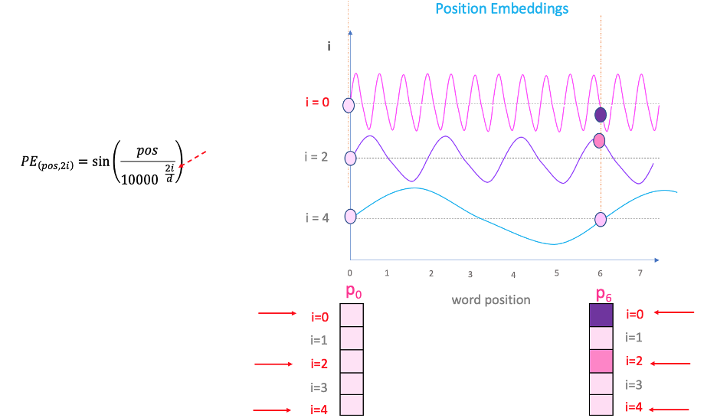
Positional Encoding Functions
we can generate different frequencies for the positional encoding (PE) for each position and each dimension i of the 512 dimensions of the word embedding vector

Slide 10
Code translation of Positional Encoding equation
This means that the sine function will be applied to the even numbers and the cosine function to the odd numbers.
import math
d_model = 512
pe = [[0 for i in range(512)]] # [ [0] ,[0] ,[0] ,…, [0] ]
def positional_encoding(pos, pe):
for i in range(0, 510, 2):
pe[0][i] = math.sin(pos / (10000 ** ((2 * i)/d_model)))
pe[0][i+1] = math.cos(pos / (10000 ** ((2 * i)/d_model)))
return pe

Slide 11
Run Positional Encoding Function
“ The black cat sat on the couch and the brown dog slept on the rug. “
PE2 = positional_encoding(2 , pe)
[[0.9092974268256817, -0.4161468365471424, 0.9581443762382829,-0.28628544196824235, 0.9870462513484951, -0.16043596136428848, 0.9991642001884493, -0.04087665668540447, 0.9974799976053368, 0.07094825140380359, 0.9847029979641517, 0.17424122876177084, 0.9632266229537682, 0.2686902916613834, 0.9351182995391969,
…,
6.796416657885114e-08, 0.9999999999999977, 6.324555320336754e-08, 0.999999999999998, 5.88545435241856e-08, 0.9999999999999982, 2.8660251404739253e-08, 0.9999999999999996, 2.6670428643266477e-08, 0.9999999999999997, 2.4818755215034388e-08, 0.9999999999999997, 2.309563969378916e-08, 0.9999999999999998, 2.149215656642635e-08,
0.9999999999999998]]
PE10 = positional_encoding(10 , pe)
[[-0.5440211108893698, -0.8390715290764524, 0.11877648322563235, -0.992921017519798, 0.6926341820804329, -0.7212890473407798, 0.9791747791427247, -0.20301909242925015, 0.937632744137416, 0.3476274401156199, 0.6404780171615888, 0.7679765032426185, 0.2090770042048824, 0.9778991800347885, -0.23791767948763887, 0.9712853225428753, -0.6129367614854907, 0.7901319677241763,
……,
2.942727176209239e-07, 0.9999999999999567, 2.738419634264327e-07, 0.9999999999999625, 2.548296747979319e-07, 0.9999999999999676, 0.9999999999999898, 1.33352143216332e-07, 0.9999999999999911, 1.2409377607517164e-07, 0.9999999999999923, 1.1547819846894556e-07, 0.9999999999999933, 1.0746078283213155e-07, 0.9999999999999942]]

Slide 12
Results
cosine_similarity(black, brown)= [[ 0.9998901]] cosine_similarity(PE2, PE10)= [[ 0.8600013]]
The encoding of the position shows a lower similarity value than the word embedding similarity.
Note: word embeddings will vary with the corpus used to train them.
from sklearn.metrics.pairwise import cosine_similarity

Slide 13

How to add the positional encoding to the word embedding vectors?

Slide 14
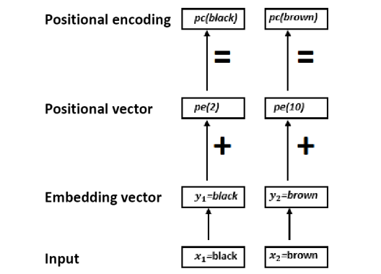
Positional Encoding Function
adding the positional encoding vector to the word embedding vector.
pc(black)=y1+pe(2)
pc(brown)=y2+pe(10)
The Problem: we might lose the information of the word embedding, which will be minimized by the positional encoding vector
(Figure adapted from Rothman, 2021, p. 15)

Slide 15
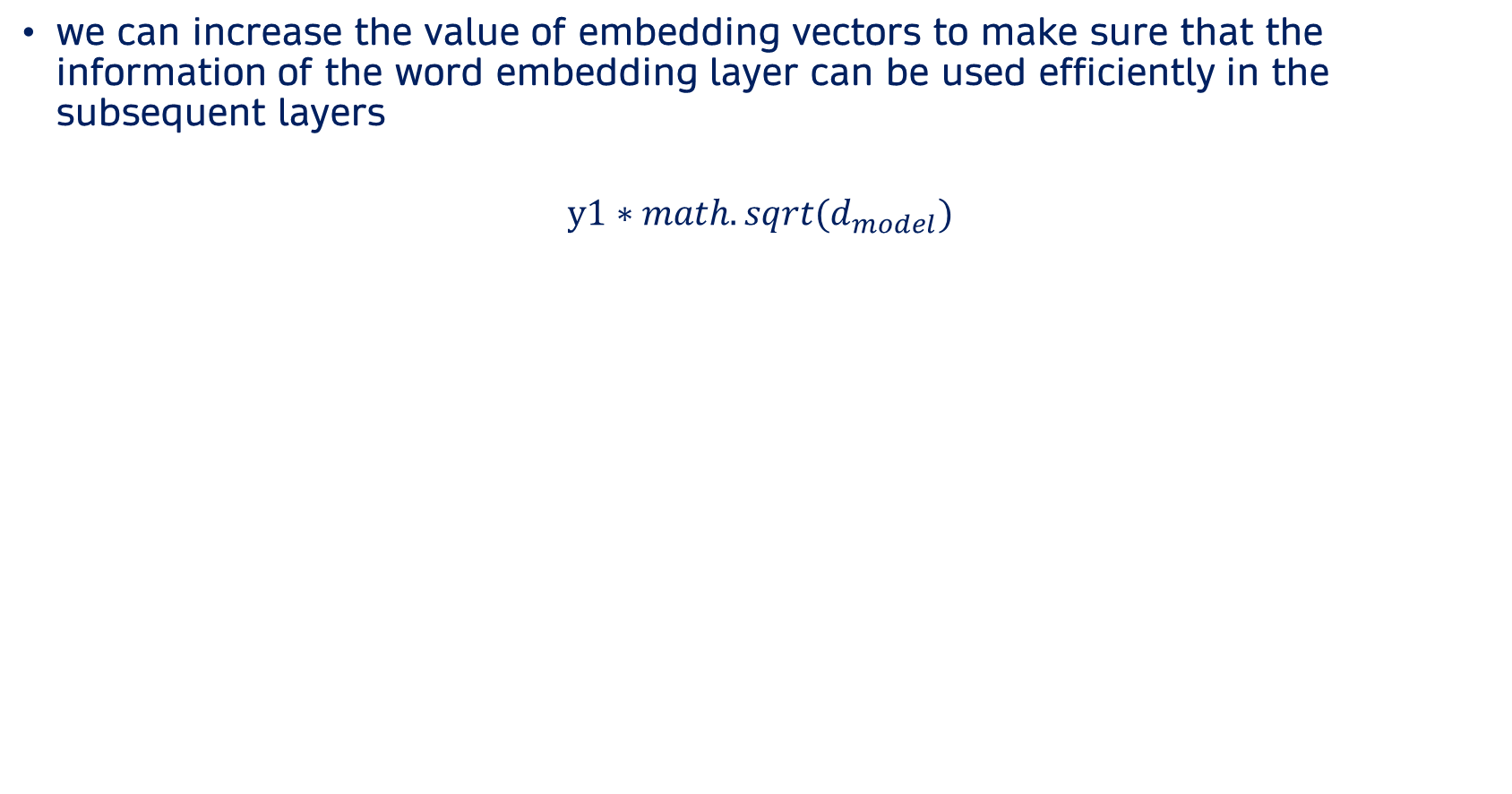
Solution of losing the information of the word embedding
we can increase the value of embedding vectors to make sure that the information of the word embedding layer can be used efficiently in the subsequent layers
$$y1∗math.sqrt(d_{model})$$
for i in range(0, 512, 2): pe[ 0][i] = math.sin(pos / (10000 ** ((2 * i)/d_model))) pc[ 0][i] = (y[ 0][i]*math.sqrt(d_model))+ pe[0][i] pe[ 0][i+1] = math.cos(pos / (10000 ** ((2 * i)/d_model))) pc[ 0][i+1] = (y[ 0][i+1]*math.sqrt(d_model))+ pe[0][i+1]
pc(black)= [[ 9.09297407e-01 -4.16146845e-01 9.58144367e-01 -2.86285430e-01 9.87046242e-01 -1.60435960e-01 9.99164224e-01 -4.08766568e-02 … 2.66704294e-08 1.00000000e+00 2.48187551e-08 1.00000000e+00 2.30956392e-08 1.00000000e+00 2.14921574e-08 1.00000000e+00]]

Slide 16
The Final Output
Note: The output of this algorithm, which is not rule-based, might slightly vary
during each run.
cosine_similarity(pc(black), pc(brown)= [[0.9627094]]

Slide 17

Summary
word similarity = 0.99
positional encoding vector similarity = 0.86
final positional encoding similarity = 0.96
$$y∗math.sqrt(d_{model})$$
The
black
+
…
cat
…
…
…
rug
Encoding stack
Token Embeddings
Positional Encoding

Slide 18



